Slide 1
Project Management Tools
By David, Eldar and Kirsten

Slide 2
Contents
Project Management Tools
Comparison
Case Studies and Practical Uses

Slide 3

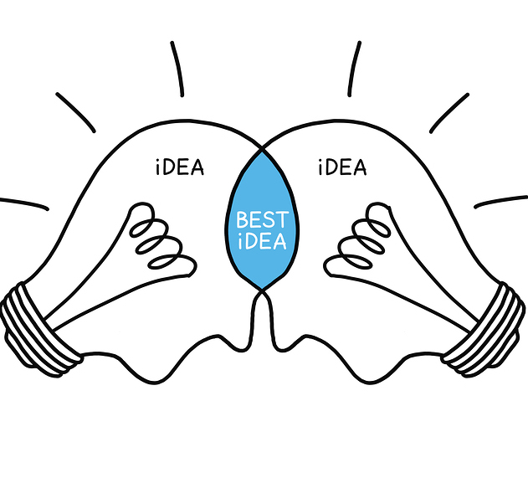


Project Management Tools
Definition
General features
Planning/scheduling
Collaboration
Documentation
Evaluation

Slide 4
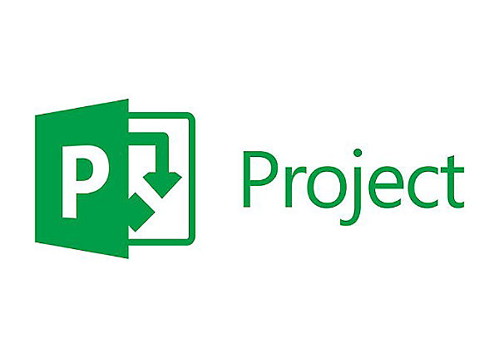


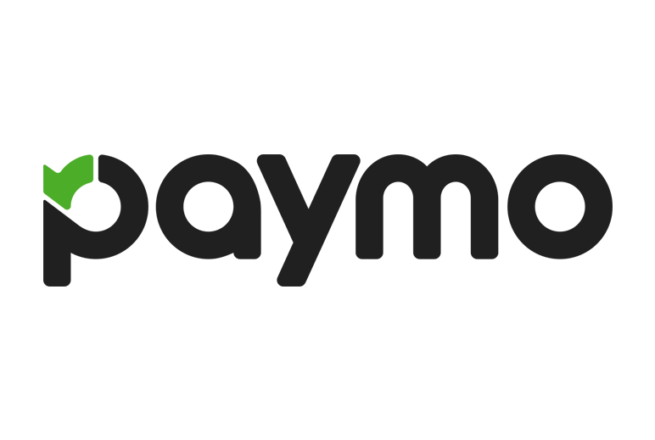
Variety of tools
Microsoft Project
Liquid Planner
Zoho Project
Paymo

Slide 5
Comparison
Criterion:
Familiarity & Ease of use
Cost
Project management foundation/base features
Extra features

Slide 6
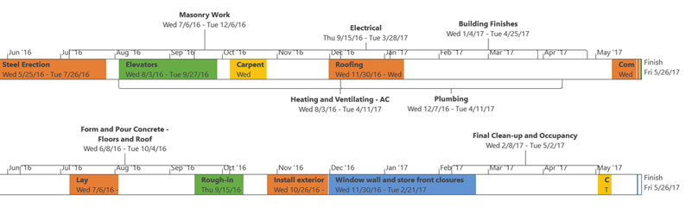
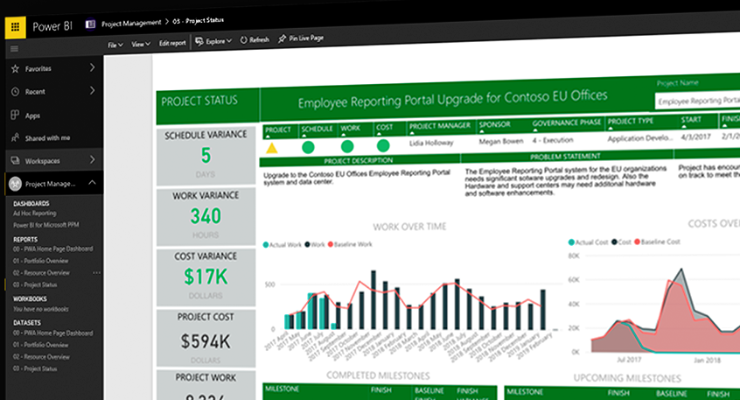
Microsoft Project
Excellent familiarity
Cloud based solutions range from £5.30 - £41.50
Base features are well established
Extra features
Built-in templates
“Out-of-the-box” reports
Multiple timelines
Real time reporting

Slide 7
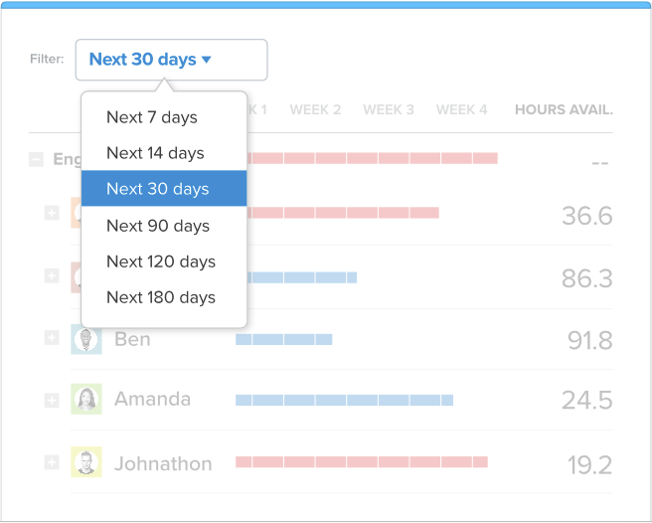
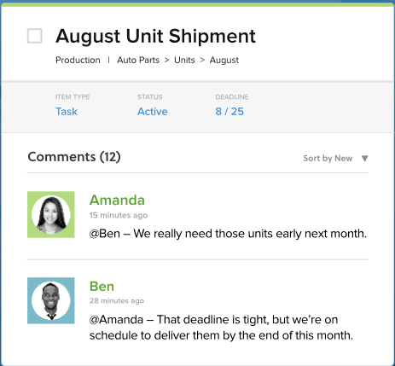
LiquidPlanner
Easy to use and concise UI
$45-$69 /mo per user
Has all fundamental features
Extra features

Slide 8
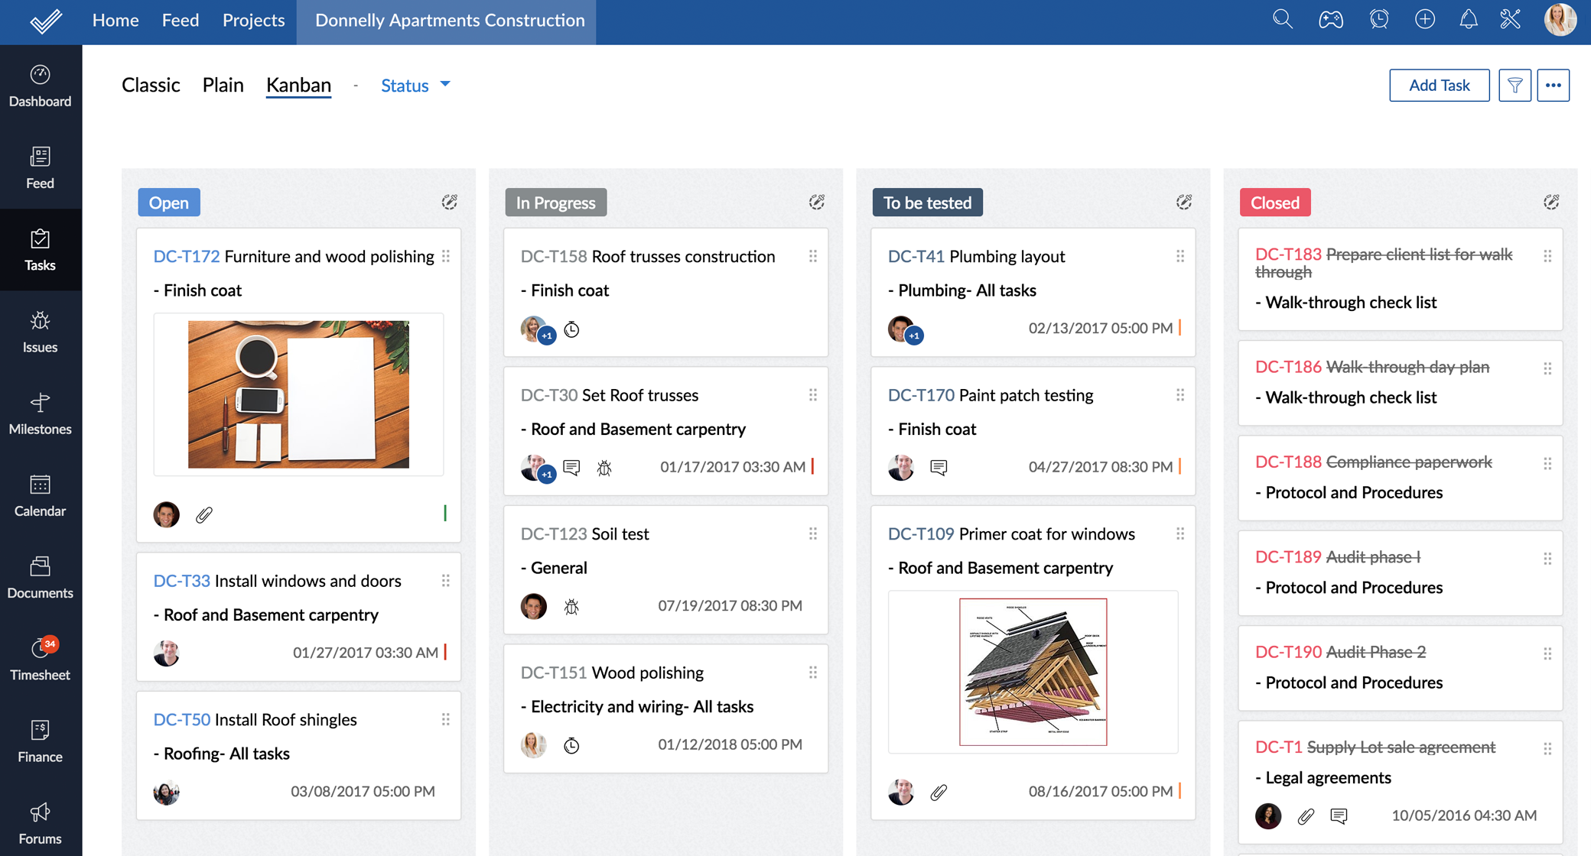
Zoho Project
Looks much like social media platform
$20-£125 /mo
Solid base features
Extra features

Slide 9
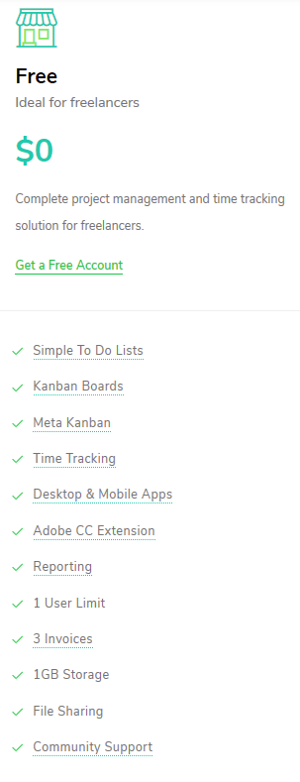
Paymo
UI similar to Liquid Planner/Zoho Projects
$0 - $15.16 per user /mo
Base features implemented have learning curve
Task tracking and mobile versions
Integration

Slide 10
Rankings
Best out of box (familiarity and ease of use): Microsoft Project
Cheapest: Paymo
Best base features: LiquidPlanner
Best extra features: Paymo
Winner: Paymo

Slide 11

Case Study 1
Brightmouth College
Points to consider:
New Information System Developer
One person managing
Must collaborate with future and current users
Notes:
Microsoft Project:
Widely used
Gantt Chart to organise tasks and assign resources
Skype and SharePoint integration
Liquid Planner:
Custom training for quick integration
Reports allow manager to see everyone's progress
Comments on tasks
Zoho Projects:
Features to help planning and info management - Gantt chart
Resource utilisation chart helps manager distribute tasks
Chats to discuss in
Paymo:
Desktop app monitors progress. New manager can see everyone is working(or not!)
Simple to use
No chats built in but can integrate live chat software

Slide 12
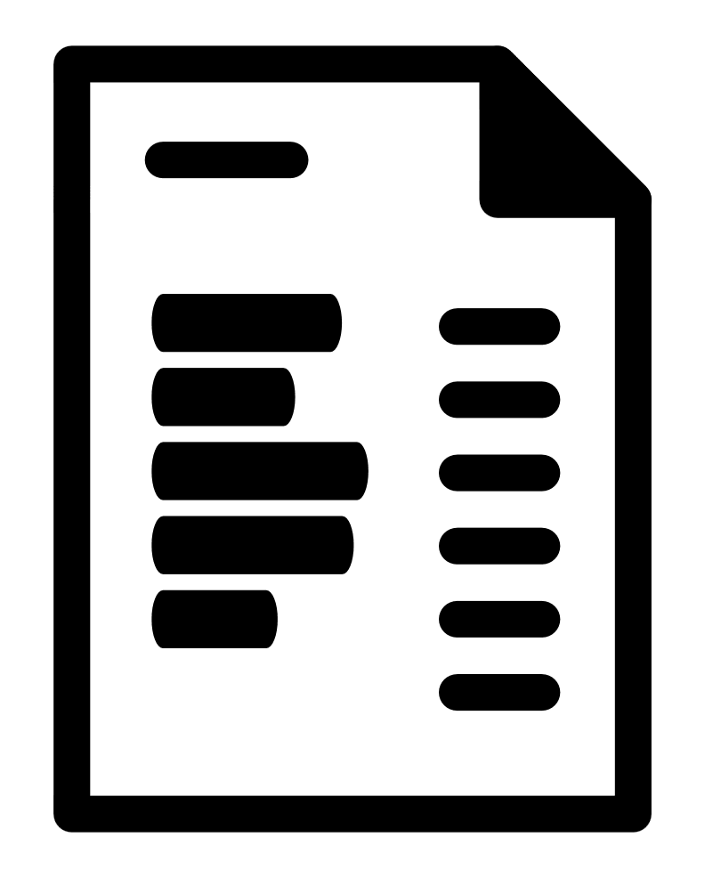
Case Study 2
IOE
Points to consider:
New Project Manager
Must collaborate with clients
Extension of existing system
Notes:
Microsoft Project:
Widely used
Skype and SharePoint integration
Analytics
Liquid Planner:
Reports allow manager to see progress
Client portal
Comments on tasks
Zoho Projects:
Archive option, if new employees are required to get up to speed
Clients can get their own profile page and use forums or chat to communicate
Documents containing invoice information can be shared
Paymo:
Desktop app monitors progress. New manager can see everyone is working(or not!)
Live reports and chats for team
File sharing

Slide 13

Practical Uses
Our projects:
Small groups
Short time frames
No official manager
Often working at uni or home
Notes:
Microsoft Project:
Prioritize tasks
Known software
Integration Office 365 free for students
App + cloud based option
Liquid Planner:
Prioritize tasks
Specific features for IT teams
Only manager can view everyone's progress
App + cloud based
Zoho Projects:
Prioritize tasks
Sharing
Customisation
Online + cloud based
Paymo:
Free version
Simple to use
Affordable
App(no phone app)

Slide 14
Thank you, any questions?

Slide 15
Sources
https://reviews.financesonline.com
https://www.zoho.com/projects/social-project-management.html
https://www.projectmanager.com/training/how-to-choose-an-online-project-management-tool
https://www.workzone.com/blog/choosing-project-management-software/
https://products.office.com/en-gb/project/project-and-portfolio-management-software
https://www.liquidplanner.com/features/
https://www.wrike.com/project-management-guide/faq/what-are-project-management-tools/
https://www.zoho.eu/projects/features.html
https://www.paymoapp.com/complete-feature-list/

